Slide 1
Network Layer: Control Plane
Goal: understand principles behind network control plane
traditional (intra-domain) routing algorithms
SDN controllers
and their instantiation, implementation in the Internet:
OSPF, RIP, OpenFlow, ODL and ONOS controllers
The following will be discussed in separate lecture notes
inter-domain routing & BGP
Internet Control Message Protocol: ICMP
network management and SNMP
Readings: Textbook: Chapter 5, Sections 5.1-5.3 & 5.5

Slide 2
Network Layer Functions
Recall: two network-layer functions:
forwarding: move packets from router’s input to appropriate router output
data plane
routing: determine route taken by packets from source to destination
control plane
Two approaches to structuring network control plane:
per-router control (traditional)
logically centralized control (software defined networking)
2

Slide 3

Per-router Distributed Control Plane
Individual routing algorithm components in each and every router interact with each other in control plane to compute forwarding tables
Routing
Algorithm
control
plane
data
plane

Slide 4
Logically Centralized Control Plane
A distinct (typically remote) controller interacts with local control agents (CAs) in routers to compute forwarding tables
Remote Controller
control
plane
data
plane
CA
CA
CA
CA
CA

Slide 5
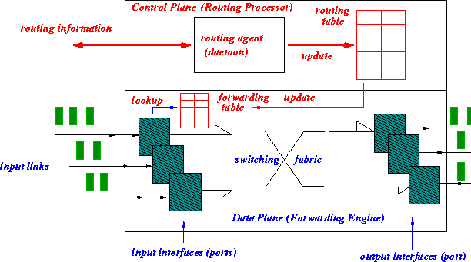
Routing & Forwarding: Logical View of a (Classical) Router
5
B
3
C
2
5
A
2
1
F
3
1
2
D
1
E
Notes:
Here is an abstract view of the internals of a typical router. We can separate the functionality of a router into control plane and data plane. The control plane is responsible for exchanging routing information (control packets) with other routers and making routing decisions. Generally, there exists a route processor to process these control packets and to update the routing table. This routing table is then condensed into a form known as forwarding table for quick lookup by the data plane. The job of data plane is to switch packets from input ports to output ports, which is essentially a forwarding.engine. Data packets flow thru this faster data plane while control packets are processed by slower control plane. Another way to look at is that routing decisions are made by control plane and forwarding lookups done by data plane.

Slide 6
IP Forwarding & IP/ICMP Protocol
Transport layer: TCP, UDP
Routing protocols
path selection
RIP, OSPF, BGP
IP protocol
addressing conventions
packet handling conventions
Network
layer
routing
table
ICMP protocol
error reporting
router “signaling”
Data Link layer (Ethernet, WiFi, PPP, …)
Physical Layer (SONET, …)
Notes:
This shows the different components of network layer under Internet protocol stack. IP protocol is concerned with addressing and packet forwarding.
The routing table itself is either setup manually or using routing protocols such as Routing Information Protocol (RIP), Open Shortest Path First (OSPF) and Border Gateway Protocol (BGP). These protocols are used to exchange information about the network between routers and update routing tables in response to link and node failures.
Internet Control Message Protocol (ICMP) is for reporting errors such as destination not reachable, number of hops exceeded the specified maximum etc.

Slide 7
Routing: Issues
How are routing tables determined?
Who determines table entries?
What info used in determining table entries?
When do routing table entries change?
Where is routing info stored?
How to control routing table size?
Answer these questions, we are done!

Slide 8
Routing Protocols
Routing protocol goal: determine “good” paths (equivalently, routes), from sending hosts to receiving host, through network of routers
path: sequence of routers packets will traverse in going from given initial source host to given final destination host
“good”: least “cost”, “fastest”, “least congested”
routing: a “top-10” networking challenge!

Slide 9
Graph Abstraction of the Network
5
v
3
w
2
5
u
2
1
z
3
1
2
x
y
1
graph: G = (N,E)
N = set of routers = { u, v, w, x, y, z }
E = set of links ={ (u,v), (u,x), (v,x), (v,w), (x,w), (x,y), (w,y), (w,z), (y,z) }
aside: graph abstraction is useful in other network contexts, e.g.,
P2P, where N is set of peers and E is set of TCP connections

Slide 10
Graph Abstraction: Costs
5
c(x,x’) = cost of link (x,x’)
e.g., c(w,z) = 5
cost could always be 1, or
inversely related to bandwidth,
or inversely related to
congestion
v
3
w
2
5
u
2
1
z
3
1
2
x
y
1
cost of path (x₁, x₂, x₃,…, x_{p}) = c(x₁,x₂) + c(x₂,x₃) + … + c(x_{p-1},x_{p})
key question: what is the least-cost path between u and z ?
routing algorithm: algorithm that finds that least cost path

Slide 11
Routing Algorithms/Protocols
Issues Need to Be Addressed:
Route selection may depend on different criteria
Performance: choose route with smallest delay
Policy: choose a route that doesn’t cross .gov network
Adapt to changes in network topology or condition
Self-healing: little or no human intervention
Scalability
Must be able to support large number of hosts, routers

Slide 12
Classical Distributed Routing Paradigms
Hop-by-hop Routing
Each packet contains destination address
Each router chooses next-hop to destination
routing decision made at each (intermediate) hop!
packets to same destination may take different paths!
Example: IP’s default datagram routing
Source Routing
Sender selects the path to destination precisely
Routers forward packet to next-hop as specified
Problem: if specified path no longer valid due to link failure!
Example:
IP’s loose/strict source route option (you’ll see later)
virtual circuit setup phase (or MPLS)

Slide 13
Centralized vs. Distributed Routing Algorithms
Centralized:
A centralized route server collects routing information and network topology, makes route selection decisions, then distributes them to routers
Distributed:
Routers cooperate using a distributed protocol
to create mutually consistent routing tables
Two standard distributed routing algorithms
Link State (LS) routing
Distance Vector (DV) routing

Slide 14
Link State vs. Distance Vector
Both assume that
The address of each neighbor is known
The cost of reaching each neighbor is known
Both find global information
By exchanging routing info among neighbors
Differ in info exchanged and route computation
LS: tells every other node its distance to neighbors
DV: tells neighbors its distance to every other node

Slide 15
Link State Algorithm
Basic idea: Distribute to all routers
Topology of the network
Cost of each link in the network
Each router independently computes optimal paths
From itself to every destination
Routes are guaranteed to be loop free if
Each router sees the same cost for each link
Uses the same algorithm to compute the best path
Notes:
Under link state routing, each router gathers state of all the links in the network and then independently computes paths. Cost can be any generic metric capturing the link characteristics such bandwidth or delay.

Slide 16
Topology Dissemination
Each router creates a set of link state packets (LSPs)
Describing its links to neighbors
LSP contains
Router id, neighbor’s id, and cost to its neighbor
Copies of LSPs are distributed to all routers
Using controlled flooding
Each router maintains a topology database
Database containing all LSPs
Notes:
What is the cost of controlled flooding? A router would not forward an LSP more than once. Since each LSP carries a sequence number, a router can discard the duplicates by matching the originator and the sequence numbers with its LSP database.

Slide 17
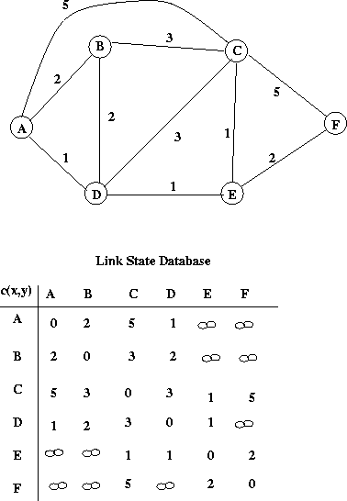
Topology Database: Example
5
B
3
C
2
5
A
2
1
F
3
1
D
E
2
1
link state database

Slide 18
Constructing Routing Table: Dijkstra’s Algorithm
Given the network topology
How to compute shortest path to each destination?
Some notation
X: source node
N: set of nodes to which shortest paths are known so far
N is initially empty
D(V): cost of known shortest path from source X
C(U,V): cost of link U to V
C(U,V) = if not neighbors

Slide 19
Dijsktra’s Algorithm (at Node X)
Initialization
N = {X}
For all nodes V
If V adjacent to X, D(V) = C(X,V)
else D(V) =
Loop
Find U not in N such that D(U) is smallest
Add U into set N
Update D(V) for all V not in N
D(V) = min{D(V), D(U) + C(U,V)}
Until all nodes in N

Slide 20
Dijkstra’s Algorithm: Example
D(v)
p(v)
D(w)
p(w)
D(x)
p(x)
D(y)
p(y)
D(z)
p(z)
Step
N'
0
u
7,u
3,u
5,u
∞
∞
1
uw
6,w
5,u
11,w
∞
2
uwx
6,w
11,w
14,x
3
uwxv
10,v
14,x
4
uwxvy
12,y
5
uwxvyz
x
9
notes:
construct shortest path tree by tracing predecessor nodes
ties can exist (can be broken arbitrarily)
5
7
4
8
u
3
w
y
z
2
3
7
4
v

Slide 21
Dijkstra’s Algorithm: Another Example
Step
0
1
2
3
4
5
start N
A
AD
ADE
ADEB
ADEBC
ADEBCF
D(B),p(B)
2,A
2,A
2,A
D(C),p(C)
5,A
4,D
3,E
3,E
D(D),p(D)
1,A
D(E),p(E)
infinity
2,D
D(F),p(F)
infinity
infinity
4,E
4,E
4,E
5
B
3
C
2
5
A
2
1
F
3
1
2
D
E
1
Notes:
Suppose A wants to compute shortest paths to all other nodes. Initialization is like step 0. We add A itself to N and set the distance to all the neighbors as the cost of direct links and all others as infinity. Here D(B) is set 2 and D(E) set to infinity because B is a neighbor and E is not.
Now in step 1, among all those nodes that are not in N, we select a node with the shortest distance. In this case D is that node with distance of 1. First, we add D to the set N. Then we update the distances of other nodes if they can be made shorter by going thru D. In this case we can improve the distance to C from 5 to 4 by going thru D instead of using the direct link. Similarly E can now be reached with distance 2.
This way in each step, we pick the node with the shortest distance, add it to set N and update the distance of all other nodes not in N. After k iterations, shortest paths to nearest k neighbors are known. This process terminates after all the nodes are added to N.
This algorithm can be viewed as the construction of shortest paths spanning tree with source node as the root. In such a tree, there is exactly one path from the source node to any other node and that is the shortest path.

Slide 22
Routing Table Computation
5
3
B
C
2
5
A
2
F
1
3
1
2
D
E
1
Notes:
Now we know how to construct a shortest paths spanning tree. But what we want is the routing table. Question is how do we get the routing table from this tree? Routing table is essentially a mapping from destination to next hop. This can be obtained very easily from the shortest paths spanning tree. Consider each node and the path to that node. The first node along the path is the next hop.

Slide 23
Dijkstra’s Algorithm: Discussion
algorithm complexity: n nodes
each iteration: need to check all nodes, w, not in N
n(n+1)/2 comparisons: O(n²)
more efficient implementations possible: O(nlogn)
oscillations possible:
e.g., support link cost equals amount of carried traffic:
A
A
A
A
1
1+e
2+e
0
0
2+e
2+e
0
D
B
D
B
D
B
D
B
0
0
1+e
1
0
0
1+e
1
0
C
e
0
0
1
0
0
1
C
C
1+e
C
1
e
initially
given these costs,
find new routing….
resulting in new costs
given these costs,
find new routing….
resulting in new costs
given these costs,
find new routing….
resulting in new costs

Slide 24
Distance Vector Routing
A router tells neighbors its distance to every router
Communication between neighbors only
Based on Bellman-Ford algorithm
Computes “shortest paths”
Each router maintains a distance table
A row for each possible destination
A column for each neighbor
D_{X}(Y,Z) : distance from X to Y via Z
D_{X}(Y): = min _{Z} {D_{x}(Y,Z)}: shortest path from X to Y
Exchanges distance vector with neighbors
Distance vector: current least cost from X to each destination
Notes:
So far we have talked about link state routing. Under link state routing each router receives complete information about the network topology and computes shortest paths using Dijkstra’s algorithm. Now we will discuss a different routing protocol called distance vector Routing.
Under distance vector routing, a router informs its neighbors about the distance from that router to every other router in the network. Unlike in link state routing, here information is exchanged only between neighbors. It is based on Bellman-Ford algorithm for computing shortest paths. We will go through an example to see how this works.
Under distance vector routing, each router maintains a distance table. A row for each possible destination and a column for each neighbor. An entry in router X’s table corresponding to a row Y and a column Z is the distance from X to Y via Z.
Given a distance table we can find the shortest distance to a destination, i.e., the smallest value in the row corresponding to the destination. A list of <destination, shortest distance> tuples is called a distance vector and these distance vectors are exchanged between neighbors.

Slide 25
Distance Table: Example
cost to destination via
D ()
A
B
C
D
A
1
7
6
4
B
14
8
9
11
D
5
5
4
2
_{E}
B
1
C
7
A
8
2
1
destination
E
D
2
Notes:
Lets look at an example. Here A, B, C, D, and E are routers and the links are labeled with their costs. And this is a distance table at router E. You can see that there is one row per each destination an one column per each neighbor.
If you look at the third row, it says that you can reach C via A with cost 6, via B with cost 9 and via D with 4. So the shortest distance to C is 4 via D. If E were to advertise its distance vector it will send <A,1>,<B,5>,<C,4>,<D,2>.

Slide 26
From Distance Table to Routing Table
cost to destination via
Outgoing link
to use, cost
A
1
7
6
4
A
B
C
D
D ()
A
B
C
D
B
14
8
9
11
D
5
5
4
2
_{E}
A ,1
D, 5
D, 4
D, 2
destination
destination
Distance table
Routing table
(or a distance vector)
Notes:
What we are really interested in is the routing table. How do we create a routing table from this distance table. Pretty simple. For example, to reach B the shortest path is via D. So the next hop for routing to B is D. We can get the whole routing table this way.
Now the question is how do we compute this distance table. That’s where we use Bellman-Ford algorithm.

Slide 27
Distance Vector Algorithm
Bellman-Ford equation (dynamic programming)
let
d^{x}(y) := cost of least-cost path from x to y
then
d^{x}(y) = min {c(x,v) + d^{v}(y) }
v
cost from neighbor v to destination y
cost to neighbor v
min taken over all neighbors v of x

Slide 28
Bellman-Ford Example
5
clearly, d_{v}(z) = 5, d_{x}(z) = 3, d_{w}(z) = 3
v
3
w
2
5
u
z
B-F equation says:
2
1
3
1
2
d_{u}(z) = min { c(u,v) + d_{v}(z),
c(u,x) + d_{x}(z),
c(u,w) + d_{w}(z) }
= min {2 + 5,
1 + 3,
5 + 3} = 4
x
y
1
node achieving minimum is next
hop in shortest path, used in forwarding table

Slide 29
Distance Vector Algorithm
D_{x}(y) = estimate of least cost from x to y
x maintains distance vector D_{x} = [D_{x}(y): y є N ]
node x:
knows cost to each neighbor v: c(x,v)
maintains its neighbors’ distance vectors. For each neighbor v, x maintains D_{v} = [D_{v}(y): y є N ]

Slide 30
Distance Vector Algorithm
key idea:
from time-to-time, each node sends its own distance vector estimate to neighbors
when x receives new DV estimate from neighbor, it updates its own DV using B-F equation:
D_{x}(y) ← min_{v}{c(x,v) + D_{v}(y)} for each node y ∊ N
under minor, natural conditions, the estimate D_{x}(y) converge to the actual least cost d_{x}(y)

Slide 31
Distance Vector Algorithm
iterative, asynchronous: each local iteration caused by:
local link cost change
DV update message from neighbor
distributed:
each node notifies neighbors only when its DV changes
neighbors then notify their neighbors if necessary
each node:
wait for (change in local link cost or msg from neighbor)
recompute estimates
if DV to any dest has changed, notify neighbors

Slide 32
D_{x}(z) = min{c(x,y) + D_{y}(z), c(x,z) + D_{z}(z)}
= min{2+1 , 7+0} = 3
D_{x}(y) = min{c(x,y) + D_{y}(y), c(x,z) + D_{z}(y)} = min{2+0 , 7+1} = 2
node x
table
cost to
cost to
x y z
x y z
x
0 2 7
x
0
2
3
y
y
2 0 1
from
∞
∞
∞
from
z
∞
∞
∞
z
7 1 0
node y
table
cost to
x y z
y
2
1
x
∞
∞
z
∞
2 0 1
x
from
y
7
z
∞
∞
∞
node z
table
cost to
x y z
x
∞ ∞ ∞
from
y
∞
∞
∞
z
7
1
0
time

Slide 33
D_{x}(z) = min{c(x,y) + D_{y}(z), c(x,z) + D_{z}(z)}
= min{2+1 , 7+0} = 3
D_{x}(y) = min{c(x,y) + D_{y}(y), c(x,z) + D_{z}(y)} = min{2+0 , 7+1} = 2
node x
table
cost to
cost to
cost to
x y z
x y z
x y z
x
0 2 7
x
0
2
3
x
0 2 3
y
y
2 0 1
from
∞
∞
∞
from
y
2 0 1
z
z
from
∞
∞
∞
7 1 0
z
3 1 0
node y
table
cost to
cost to
cost to
x y z
x y z
x y z
y
2
1
x
∞
∞
x
0 2 7
∞
2 0 1
x
0 2 3
x
z
from
y
y
2 0 1
y
7
from
from
2 0 1
z
∞
∞
∞
z
7 1 0
z
3 1 0
node z
table
cost to
cost to
cost to
x y z
x y z
x y z
x
∞ ∞ ∞
x
0 2 7
x
0 2 3
y
y
2 0 1
from
y
∞
∞
from
2 0 1
from
∞
z
z
3 1 0
z
3 1 0
7
1
0
time
time

Slide 34
Distance Vector: Link Cost Changes
link cost changes:
node detects local link cost change
updates routing info, recalculates distance vector
if DV changes, notify neighbors
1
y
4
1
x
z
50
“good
news
travels
fast”
t₀ : y detects link-cost change, updates its DV, informs its neighbors.
t₁ : z receives update from y, updates its table, computes new least cost to x , sends its neighbors its DV.
t₂ : y receives z’s update, updates its distance table. y’s least costs do not change, so y does not send a message to z.
* Check out the online interactive exercises for more examples: http://gaia.cs.umass.edu/kurose_ross/interactive/

Slide 35
Distance Vector: Link Cost Changes
link cost changes:
node detects local link cost change
bad news travels slow - “count to infinity” problem!
44 iterations before algorithm stabilizes: see text
60
y
4
1
x
z
50
“Count-to-Infinity” Problem: A Simple Example
1
1
X
Y
Z
2
Notes:
Consider this very simple case. Lets come up with the distance table. Since Y is directly connected to Z, distance from Y to Z is 1. Also, X can reach Z with distance 2. But the interesting thing is that Y thinks it can reach Z thru X with distance 3 (2+1).
Now suppose link from Y to Z goes down. Y senses that and advertises new distance of 3 (which is via X). X recalculates its distance to Z as 4 and readvertizes. This goes on forever with both X and Y counting to infinity before they realize that Z is unreachable.
What is the basic problem here. Y doesn’t have sufficient information to figure out whether there exists another path from X to Z. It can’t distinguish between the cases with and without the dotted link of cost 2. So what is the solution to this problem?

Slide 36
“Fixes” to Count-to-Infinity Problem
Split horizon
A router never advertises the cost of a destination to a neighbor
If this neighbor is the next hop to that destination
Split horizon with poisonous reverse
If X routes traffic to Z via Y, then
X tells Y that its distance to Z is infinity
Instead of not telling anything at all
Accelerates convergence
Notes:
One solution to address this problem is split horizon. It is a simple rule that says a router should never advertise the cost of a destination to a neighbor if this neighbor is the next hop to reach that destination. In the previous example, according to split horizon rule, X wouldn’t say anything about Z to Y.
A variation of this rule is called split horizon with poisonous reverse. In this case, instead of keeping quiet X tells Y that its distance to Z is infinity. This helps accelerate convergence.

Slide 37
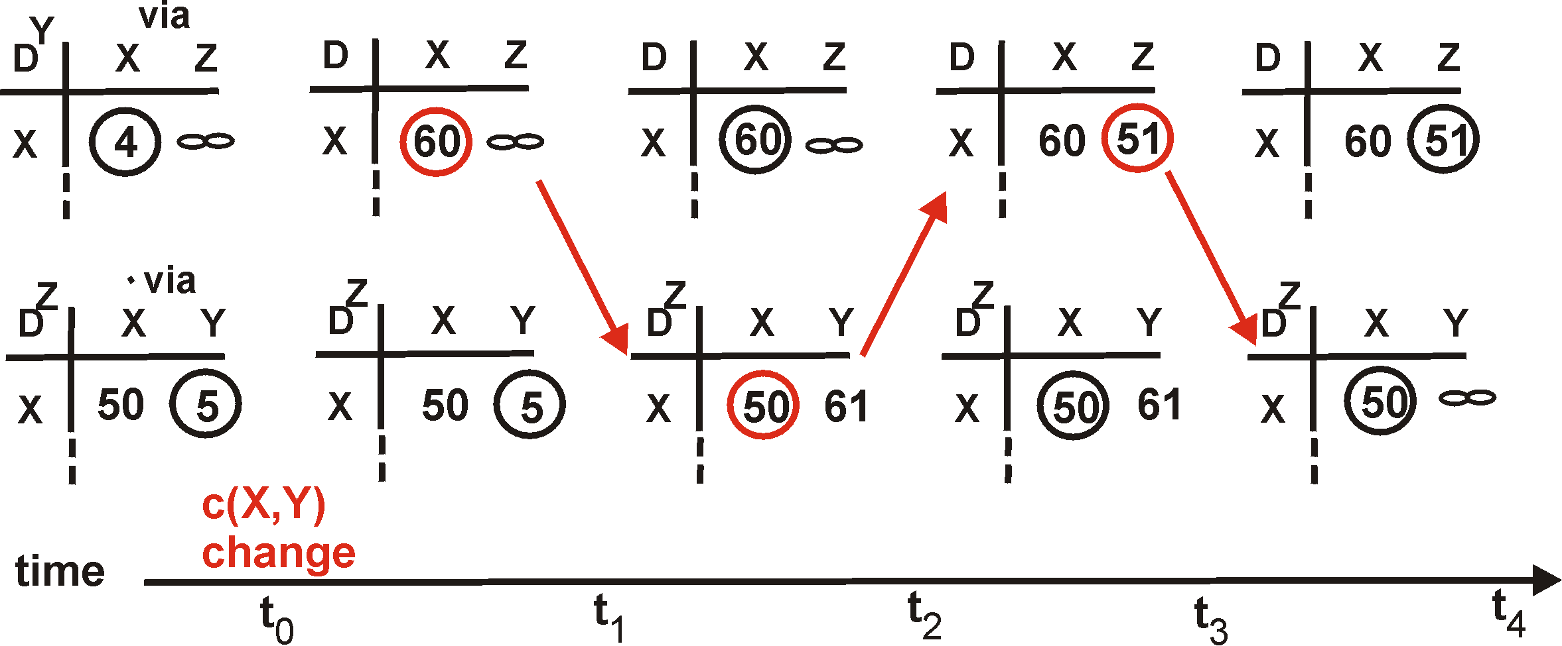
Split Horizon with Poisoned Reverse
If Z routes through Y to get to X :
Z tells Y its (Z’s) distance to X is infinite (so Y won’t route to X via Z)
60
Y
4
1
X
Z
50
algorithm
terminates
Notes:
Lets look at the earlier example again. Note that the initially the cost to reach Z from Y via X is infinity since Y is the next hop for Z to reach X. When the cost changes to 60, Y senses it, updates its table and notifies Z. The router Z realizes that direct link to X is shorter than going thru Y and updates its routing table. It then notifies Y which updates its table and makes Z its next hop to reach X. Then as per the rule, Y announces its cost to reach X as infinity. This way routers quickly converge to stable state.
Does this solution completely solve the count to infinity problem?

Slide 38
“Fixes” to Count-to-Infinity Problem
Split horizon
A router never advertises the cost of a destination to a neighbor
If this neighbor is the next hop to that destination
Split horizon with poisonous reverse
If X routes traffic to Z via Y, then
X tells Y that its distance to Z is infinity
Instead of not telling anything at all
Accelerates convergence
Will this completely solve count to infinity problem?
Notes:
One solution to address this problem is split horizon. It is a simple rule that says a router should never advertise the cost of a destination to a neighbor if this neighbor is the next hop to reach that destination. In the previous example, according to split horizon rule, X wouldn’t say anything about Z to Y.
A variation of this rule is called split horizon with poisonous reverse. In this case, instead of keeping quiet X tells Y that its distance to Z is infinity. This helps accelerate convergence.

Slide 39
Count-to-Infinity Problem Revisited
X
Y
Z
W
Notes:
What happens when the link Y to Z goes down. All three routers X, Y, and W together count to infinity. Split horizon solution works only when two routers are involved in a loop. So what is the solution?
To completely eliminate the problem, a router some how need to figure out the complete path to a destination. Obvious solution is to pass on the path information along with the distance vector. This path vector approach is used in BGP.

Slide 40
Link State vs Distance Vector
Tells everyone about neighbors
Controlled flooding to exchange link state
Dijkstra’s algorithm
Each router computes its own table
May have oscillations
Open Shortest Path First (OSPF)
Tells neighbors about everyone
Exchanges distance vectors with neighbors
Bellman-Ford algorithm
Each router’s table is used by others
May have routing loops
Routing Information Protocol (RIP)
Notes:
Now lets compare these two routing protocols. Under link state, a router tells everyone about its neighbors using controlled flooding. Distance vector case a router communicates with neighbors only to inform about everyone.
Link state each router gathers global information and computes its own table using Dijkstra’s algorithm. Distance vector performs distributed computation using other routers tables.
We saw that distance vector can cause routing loops. There may be frequent changes in routes in the case of link state. This results in out of order delivery of packets which is undesirable.
Both these approaches have advantages and disadvantages. Both are used in the Internet. OSPF is the most popularly used intra-domain routing protocol that is based on link state. RIP is based on distance vector which is being taken over by OSPF. BGP is an inter-domain protocol that uses path vectors.

Slide 41
Comparison of LS and DV Algorithms
message complexity
LS: with n nodes, E links, O(nE) msgs sent
DV: exchange between neighbors only
convergence time varies
speed of convergence
LS: O(n²) algorithm requires O(nE) msgs
may have oscillations
DV: convergence time varies
may be routing loops
count-to-infinity problem
robustness: what happens if router malfunctions?
LS:
node can advertise incorrect link cost
each node computes only its own table
DV:
DV node can advertise incorrect path cost
each node’s table used by others
error propagate thru network

Slide 42
Routing in the Real World
Our routing study thus far - idealization
all routers identical
network “flat”
How to do routing in the Internet
scalability and policy issues
scale: with 200 million destinations:
can’t store all destinations in routing tables!
routing table exchange would swamp links!
administrative autonomy
internet = network of networks
each network admin may want to control routing in its own network

Slide 43
Routing in the Internet
The Global Internet consists of Autonomous Systems (AS) interconnected with each other:
Stub AS: small corporation: one connection to other AS’s
Multihomed AS: large corporation (no transit): multiple connections to other AS’s
Transit AS: provider, hooking many AS’s together
Two-level routing:
Intra-AS: administrator responsible for choice of routing algorithm within network
Inter-AS: unique standard for inter-AS routing: BGP

Slide 44
Interconnected ASes
3c
3a
2c
3b
AS3
2a
1c
2b
AS2
1a
1b
1d
AS1
forwarding table configured by both intra- and inter-AS routing algorithm
intra-AS routing determine entries for destinations within AS
inter-AS & intra-AS determine entries for external destinations
Intra-AS
Routing
algorithm
Inter-AS
Routing
algorithm
Forwarding
table

Slide 45
Intra-AS vs. Inter-AS Routing
Inter-AS
routing
between
A and B
C.b
B.a
A.a
Host
h2
b
A.c
c
a
C
a
b
a
B
Host
h1
d
c
Intra-AS routing
within AS B
A
b
Intra-AS routing
within AS A
CSci4211: Network Control Plane

Slide 46
Why Different Intra- and Inter-AS Routing?
Policy:
Inter-AS: admin wants control over how its traffic routed, who routes through its net.
Intra-AS: single admin, so no policy decisions needed
Scale:
hierarchical routing saves table size, update traffic
Performance:
Intra-AS: can focus on performance
Inter-AS: policy may dominate over performance
Will Talk about Inter-AS routing (& BGP) later!

Slide 47
Intra-AS Routing
Also known as Interior Gateway Protocols (IGP)
Most common Intra-AS routing protocols:
RIP: Routing Information Protocol
OSPF: Open Shortest Path First
IS-IS: Intermediate System to Intermediate System (OSI Standard)
EIGRP: Extended Interior Gateway Routing Protocol (Cisco proprietary)

Slide 48
RIP ( Routing Information Protocol)
Distance vector algorithm
Included in BSD-UNIX Distribution in 1982
Distance metric: # of hops (max = 15 hops)
Can you guess why?
Distance vectors: exchanged among neighbors every 30 sec via Response Message (also called advertisement)
Each advertisement: list of up to 25 destination nets within AS

Slide 49
RIP: Link Failure and Recovery
If no advertisement heard after 180 sec --> neighbor/link declared dead
routes via neighbor invalidated
new advertisements sent to neighbors
neighbors in turn send out new advertisements (if tables changed)
link failure info quickly propagates to entire net
poison reverse used to prevent ping-pong loops (infinite distance = 16 hops)

Slide 50
RIP Table Processing
RIP routing tables managed by application-level process called route-d (daemon)
advertisements sent in UDP packets, periodically repeated
routed
routed
Transprt
(UDP)
Transprt
(UDP)
network forwarding
(IP) table
network
(IP)
forwarding
table
link
link
physical
physical

Slide 51
OSPF (Open Shortest Path First)
“open”: publicly available
uses link-state algorithm
link state packet dissemination
topology map at each node
route computation using Dijkstra’s algorithm
router floods OSPF link-state advertisements to all other routers in entire AS
carried in OSPF messages directly over IP (rather than TCP or UDP
link state: for each attached link
IS-IS routing protocol: nearly identical to OSPF

Slide 52
OSPF “Advanced” Features (not in RIP)
Security: all OSPF messages authenticated (to prevent malicious intrusion)
Multiple same-cost paths allowed (only one path in RIP)
For each link, multiple cost metrics for different TOS (“Type-of-Services”)
e.g., satellite link cost set “low” for best effort; high for real time)
Hierarchical OSPF in large domains.

Slide 53
Hierarchical OSPF
boundary router
backbone router
backbone
area
border
routers
area 3
internal
routers
area 1
area 2

Slide 54
Hierarchical OSPF
Two-level hierarchy: local area, backbone.
Link-state advertisements only in area
each nodes has detailed area topology; only know direction (shortest path) to nets in other areas.
Area border routers: “summarize” distances to nets in own area, advertise to other Area Border routers.
Backbone routers: run OSPF routing limited to backbone.
Boundary routers: connect to other ASes.

Slide 55
Software Defined Networking (SDN)
Internet network layer: historically has been implemented via distributed, per-router approach
monolithic router contains switching hardware, runs proprietary implementation of Internet standard protocols (IP, RIP, IS-IS, OSPF, BGP) in proprietary router OS (e.g., Cisco IOS)
different “middleboxes” for different network layer functions: firewalls, load balancers, NAT boxes, ..
~2005: renewed interest in rethinking network control plane

Slide 56
Recall: Per-Router Control Plane
Individual routing algorithm components in each and every router interact with each other in control plane to compute forwarding tables
Routing
Algorithm
control
plane
data
plane

Slide 57
Recall: Logically Centralized Control Plane
A distinct (typically remote) controller interacts with local control agents (CAs) in routers to compute forwarding tables
Remote Controller
control
plane
data
plane
CA
CA
CA
CA
CA

Slide 58
Software Defined Networking (SDN)
Why a logically centralized control plane?
easier network management: avoid router misconfigurations, greater flexibility of traffic flows
table-based forwarding (recall OpenFlow API) allows “programming” routers
centralized “programming” easier: compute tables centrally and distribute
distributed “programming: more difficult: compute tables as result of distributed algorithm (protocol) implemented in each and every router
open (non-proprietary) implementation of control plane

Slide 59

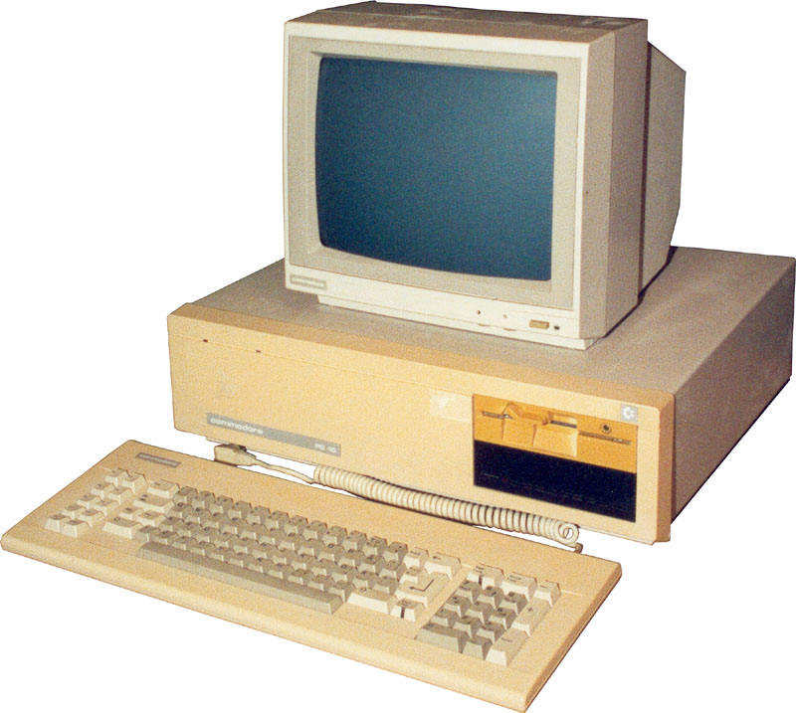
Analogy: mainframe to PC Evolution
App
App
App
App
App
App
App
App
App
App
App
Specialized
Applications
Open Interface
Specialized
Operating
System
Windows
(OS)
Linux
Mac
OS
or
or
Specialized
Hardware
Open Interface
Microprocessor
Vertically integrated
Closed, proprietary
Slow innovation
Small industry
Horizontal
Open interfaces
Rapid innovation
Huge industry

Slide 60

Traffic Engineering: Difficult Traditional Routing
5
3
v
w
5
2
u
2
1
z
3
1
2
x
y
1
Q: what if network operator wants u-to-z traffic to flow along uvwz, x-to-z traffic to flow xwyz?
A: need to define link weights so traffic routing algorithm computes routes accordingly (or need a new routing algorithm)!
Link weights are only control “knobs”: wrong!
Notes:
Note: implicit assumption here: destination based forwarding

Slide 61
Traffic Engineering: Difficult
5
3
v
w
5
2
u
2
1
z
3
1
2
x
y
1
Q: what if network operator wants to split u-to-z traffic along uvwz and uxyz (load balancing)?
A: can’t do it (or need a new routing algorithm)
Notes:
Note: implicit assumption here: destination based forwarding

Slide 62
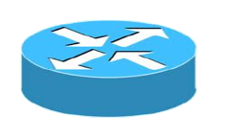
Traffic Engineering: Difficult
Networking 401
5
v
3
w
2
v
w
5
u
2
1
z
3
z
1
2
x
y
x
1
y
Q: what if w wants to route blue and red traffic differently?
A: can’t do it (with destination based forwarding, and LS, DV routing)
Notes:
Note: implicit assumption here: destination based forwarding

Slide 63
Software Defined Networking (SDN)
4. programmable control applications
…
3. control plane functions external to data-plane switches
routing
access control
load
balance
Remote Controller
control
plane
data
plane
CA
2. control, data plane separation
CA
CA
CA
CA
1: generalized“ flow-based” forwarding (e.g., OpenFlow)

Slide 64
SDN Perspective: Data Plane Switches
Data plane switches
fast, simple, commodity switches implementing generalized data-plane forwarding (Section 4.4) in hardware
switch flow table computed, installed by controller
API for table-based switch control (e.g., OpenFlow)
defines what is controllable and what is not
protocol for communicating with controller (e.g., OpenFlow)
network-control applications
…
routing
access
control
load
balance
control
plane
northbound API
SDN Controller
(network operating system)
southbound API
data
plane
SDN-controlled switches

Slide 65
SDN perspective: SDN Controller
SDN controller (network OS):
maintain network state information
interacts with network control applications “above” via northbound API
interacts with network switches “below” via southbound API
implemented as distributed system for performance, scalability, fault-tolerance, robustness
network-control applications
…
routing
access
control
load
balance
control
plane
northbound API
SDN Controller
(network operating system)
southbound API
data
plane
SDN-controlled switches

Slide 66
SDN Perspective: Control Applications
network-control apps:
“brains” of control: implement control functions using lower-level services, API provided by SND controller
unbundled: can be provided by 3rd party: distinct from routing vendor, or SDN controller
network-control applications
…
routing
access
control
load
balance
control
plane
northbound API
SDN Controller
(network operating system)
southbound API
data
plane
SDN-controlled switches

Slide 67
Components of SDN Controller
routing
access
control
load
balance
Interface layer to network control apps: abstractions API
Interface, abstractions for network control apps
…
network graph
RESTful
API
intent
Network-wide state management layer: state of networks links, switches, services: a distributed database
…
statistics
flow tables
SDN
controller
Network-wide distributed, robust state management
…
Link-state info
host info
switch info
…
communication layer: communicate between SDN controller and controlled switches
OpenFlow
SNMP
Communication to/from controlled devices

Slide 68

OpenFlow Protocol
operates between controller, switch
TCP used to exchange messages
optional encryption
three classes of OpenFlow messages:
controller-to-switch
asynchronous (switch to controller)
symmetric (misc)
OpenFlow Controller

Slide 69
OpenFlow: Controller-to-Switch Messages
Key controller-to-switch messages
features: controller queries switch features, switch replies
configure: controller queries/sets switch configuration parameters
modify-state: add, delete, modify flow entries in the OpenFlow tables
packet-out: controller can send this packet out of specific switch port
OpenFlow Controller

Slide 70
OpenFlow: Switch-to-Controller Messages
Key switch-to-controller messages:
packet-in: transfer packet (and its control) to controller. See packet-out message from controller
flow-removed: flow table entry deleted at switch
port status: inform controller of a change on a port.
OpenFlow Controller
Fortunately, network operators don’t “program” switches by creating/sending OpenFlow messages directly. Instead use higher-level abstraction at controller

Slide 71
SDN: Control/Data Plane
Interaction Example
Dijkstra’s link-state
Routing
1
S1, experiencing link failure using OpenFlow port status message to notify controller
4
5
…
network graph
RESTful
API
intent
2
SDN controller receives OpenFlow message, updates link status info
3
…
statistics
flow tables
…
3
Dijkstra’s routing algorithm application has previously registered to be called when ever link status changes. It is called.
Link-state info
host info
switch info
2
…
OpenFlow
SNMP
6
4
Dijkstra’s routing algorithm access network graph info, link state info in controller, computes new routes
1
s2
s1
s4
s3

Slide 72
SDN: Control/Data plane
Interaction Example
Dijkstra’s link-state
Routing
4
5
…
network graph
RESTful
API
intent
5
link state routing app interacts with flow-table-computation component in SDN controller, which computes new flow tables needed
3
…
statistics
flow tables
…
Link-state info
host info
switch info
2
…
6
Controller uses OpenFlow to install new tables in switches that need updating
OpenFlow
SNMP
6
1
s2
s1
s4
s3

Slide 73
OpenDaylight (ODL) Controller
…
Traffic
Engineering
ODL Lithium controller
network apps may be contained within, or be external to SDN controller
Service Abstraction Layer: interconnects internal, external applications and services
REST API
Network service apps
Basic Network Service Functions
topology
manager
switch
manager
stats
manager
Access
Control
forwarding
manager
host
manager
Service Abstraction Layer (SAL)
…
OpenFlow 1.0
SNMP
OVSDB

Slide 74
ONOS Controller
…
Network
control apps
control apps separate from controller
intent framework: high-level specification of service: what rather than how
considerable emphasis on distributed core: service reliability, replication performance scaling
northbound abstractions,
protocols
REST API
Intent
hosts
paths
flow rules
topology
ONOS
distributed core
devices
links
statistics
device
link
host
flow
packet
southbound abstractions,
protocols
OpenFlow
Netconf
OVSDB

Slide 75
SDN: Selected Challenges
hardening the control plane: dependable, reliable, performance-scalable, secure distributed system
robustness to failures: leverage strong theory of reliable distributed system for control plane
dependability, security: “baked in” from day one?
networks, protocols meeting mission-specific requirements
e.g., real-time, ultra-reliable, ultra-secure
Internet-scaling

